Slide 1

Clock Controller Unit Design Metrics: Area, Power, Software Flexibility and Congestion Impacts at System Level
Michele Chilla, Snr Engineer, QT Technologies Ireland Limited
Leonardo Gobbi, Engineer, QT Technologies Ireland Limited

Slide 2
Agenda
Problem Statements
Solution and Sub-System Under Test
Clock Controller Design Strategies
Results
Conclusion
Q&A

Slide 3
Agenda
Problem Statements
Solution and Sub-System Under Test
Clock Controller Design Strategies
Results
Conclusion
Q&A

Slide 4
Problem Statement
Modern CPUs are sequential circuits governed by a clock signal.
Clock-tree significantly contributes to power consumption and heat dissipation.
The exponential of signal-processing capability leads SoC to perform multiple functions at the same time with faster clock speed.
Limitations for long-lasting battery in mobile devices.
Notes:
Nowadays, the needs of having high-speed CPUs supporting multi-functions at the same time is the main goal for all semiconductor industries.
However, higher clock speed and heavier signal processing an increase of the signal processing burn power and this is a drawback for long-lasting batteries in mobile devices
As we know

Slide 5
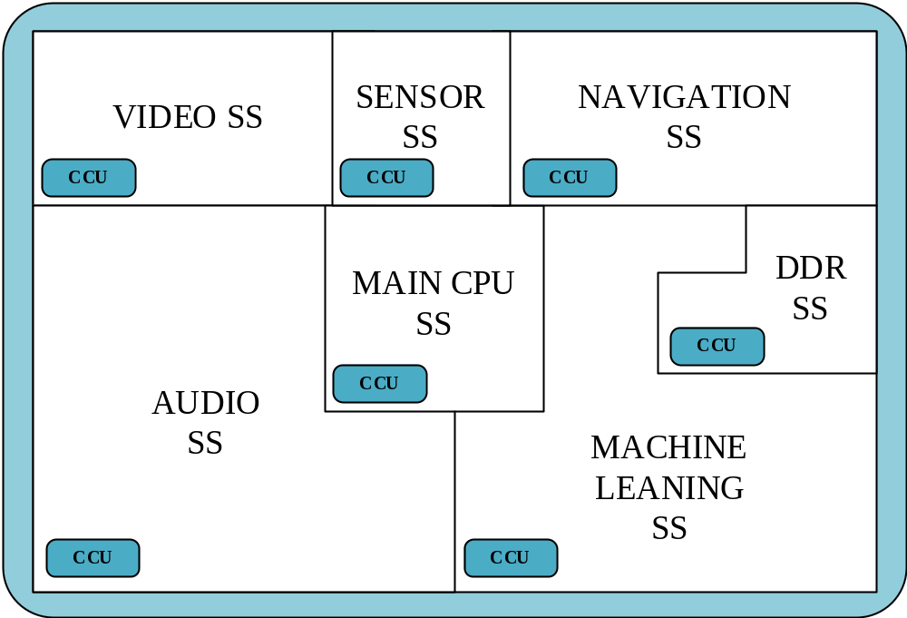
Problem Statement
Multi-Core & Multi-Clock System
allows power mitigation by using:
  Power Gating
  Clock Gating
  Dynamic Frequencies Scaling (DFS)
  Multi Clock Domain (Async Clocks)
Clock Controller Unit (CCU) Unit could
can +80 clocks for high-complex
Sub-System.
Example of Multi-Core & Multi-Clock Systems
Notes:
Solution adopted was to re-design the system and split it in smaller blocks called Sub-Systems each of them with a dedicated purpose.
This allowed designers to implement power saving techniques such us power gating which…
Another limitation is due to the need of high-speed clocks for accommodate design specification. So, another aspect that designers should encountered and face was “ how can we mitigate clock power dissipation?”
An answers came from different power technique which are appliables on clock paths such us:
- clock gating
- DSF
- Asynchronous approach.
Multi-Clock/Core approach is the key design

Slide 6
Agenda
Problem Statements
Solution and Sub-System Under Test
Clock Controller Design Strategies
Results
Conclusion
Q&A

Slide 7
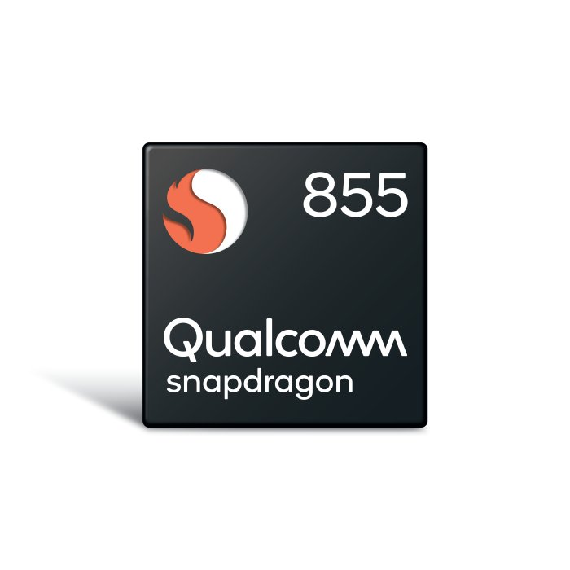
Solution and Sub-System Under Test
Aim of this work is to give guidelines to CCU designers to:
Maximize DFS and Clock Gating
Maximize flexibility in Clock-Tree routing
Multi-Core & Multi-Clock Sensor Sub-System used on Qualcomm®
Snapdragon™ 855+ Mobile Platform.
Notes:
Solution adopted was to re-design the system and split it in smaller blocks called Sub-Systems each of them with a dedicated purpose.
This allowed designers to implement power saving techniques such us power gating which…
Another limitation is due to the need of high-speed clocks for accommodate design specification. So, another aspect that designers should encountered and face was “ how can we mitigate clock power dissipation?”
An answers came from different power technique which are appliables on clock paths such us:
- clock gating
- DSF
- Asynchronous approach.
Multi-Clock/Core approach is the key design

Slide 8
Solution and Sub-System Under Test
Timing Constraints
Low-Opt CCU Design (RTL)
Timing Constraints
Mid-Opt CCU Design (RTL)
Timing Constraints
High-Opt CCU Design (RTL)
Sub-System Under Test (RTL)
Sub-System Under Test (RTL)
Sub-System Under Test (RTL)
DESIGN
CCU
CCU
CCU
SYNTHESIS
Design Compiler
Design Compiler
Design Compiler
RESULTS
COMPARISON
Results
Results
Results

Slide 9
Agenda
Problem Statements
Solution and Sub-System Under Test
Clock Controller Design Strategies
Results
Conclusion
Q&A

Slide 10
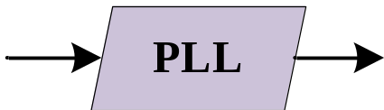
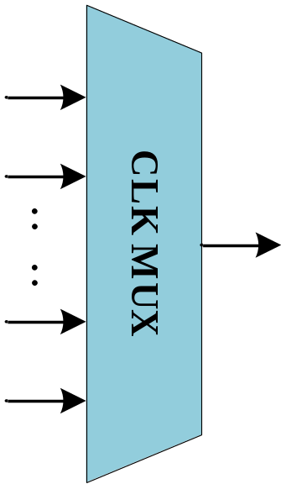
Clock Controller Design Strategies: Basic Blocks
Phase-Locked Loop (PLL):
Control system that generates an output signal whose phase is related to the phase of an input signal.
Clock Multiplexer (C-MUX):
Combinational logic circuit designed to switch one of several clock inputs source with different frequency values (e.g. External Ring-Oscillators, Digital PLLs) through to a single common output clock line by the application of a control signal.
Free Glitch during input transition.

Slide 11
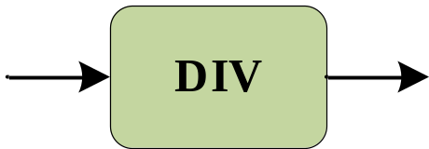
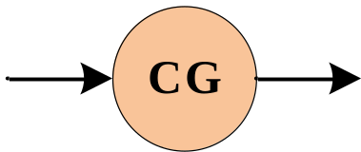
Clock Controller Design Strategies: Basic Blocks
Digital Clock Divider Cell:
Clock divider cell converts frequency of input clock into a lower frequency. Complex divider cells have the ability of dynamically set divider value based on SW configuration.
Clock Gating Cell:
Clock gating is a common technique for reducing clock power by shutting off the clock to modules by a clock enable signal. Enable signal is controlled either from software or hardware.

Slide 12
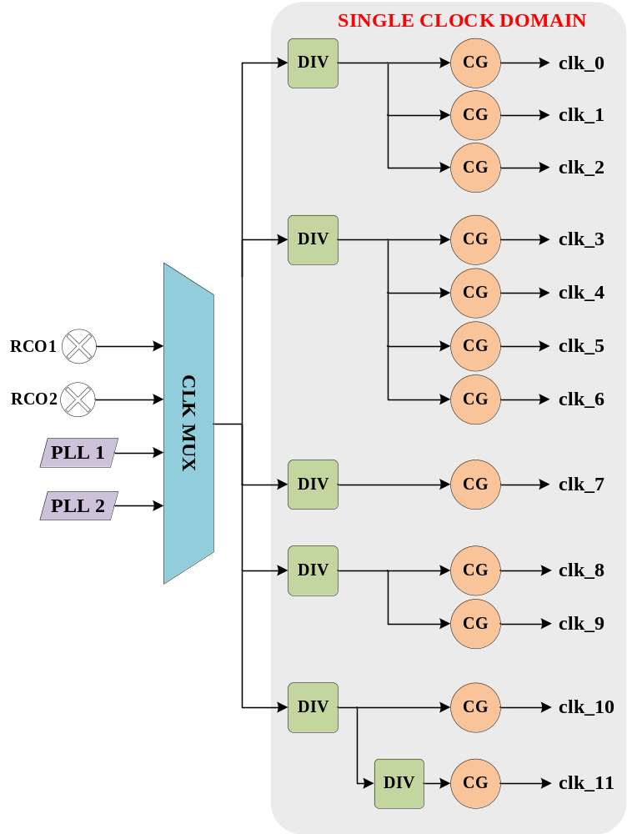
Clock Controller Design Strategies: Low-Opt
Single clock source (C-MUX)
  Poor DFS
All clocks synchronous
  tight timing requirement for Clock-Tree

Slide 13
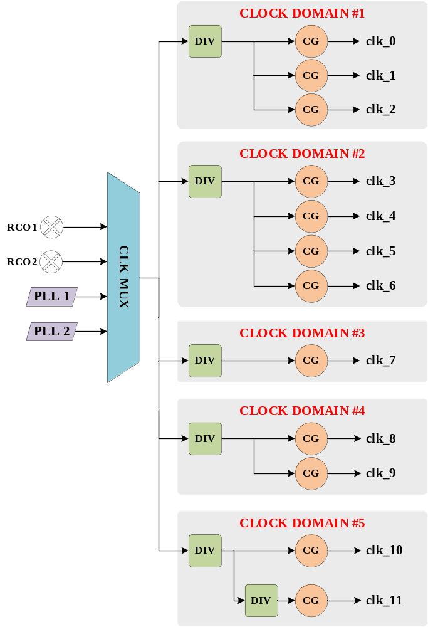
Clock Controller Design Strategies: Mid-Opt
Single clock source (C-MUX)
  Poor DFS
Clocks split in Asynchronous groups
  relaxed requirement for Clock-Tree

Slide 14
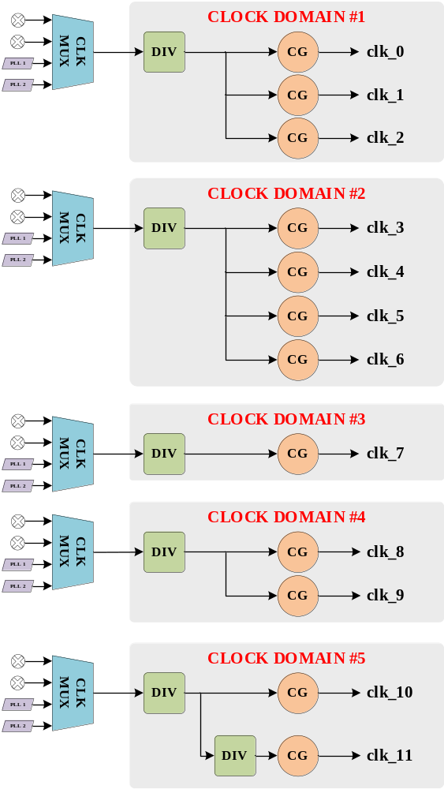
Clock Controller Design Strategies: High-Opt
Multiple clock source (C-MUX)
  High DFS
Clocks split in Asynchronous groups
  relaxed requirement for Clock-Tree
PLLs/RCOs shared between C-MUXes

Slide 15


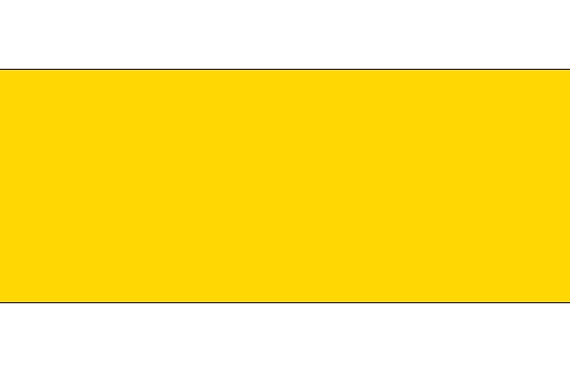
Clock Controller Design Strategies: Summary
Low-Opt CCU | Mid-Opt CCU | High-Opt CCU
STATIC POWER
Tight timing constraints High Fan-Out congestions: same CMUX drives all clock branches High Buf/Inv insertion | Relaxed timing constraints High Fan-Out congestions: same CMUX drives all clock branches Moderate Buf/Inv insertion. | Relaxed timing constraints Fan-Out congestions reduced: dedicated C-MUX per clock branch Reduce Buf/Inv insertion.
DYNAMIC POWER
Poor DFS | Poor DFS | High DFS

Slide 16
Agenda
Problem Statements
Solution and Sub-System Under Test
Clock Controller Design Strategies
Results
Conclusion
Q&A

Slide 17
Results – Outcome Methodology
Area: Gathered by the Design Compiler (DC) tool. Combo and Noncombination and Buf/Inv insertion has been also investigated.
Power: Leakage and Dynamic Power has been estimated by using existing Power Compiler (PC), an internal tool of DC.
SW Flexibility (DFS): Deducted from design.
Congestion: The Design Vision (DV) tool is to extract a topographical view of all clock branches across the entire SS down to 6 levels of connections.

Slide 18
Results – Area Comparison

Slide 19
Results – Power Comparison

Slide 20
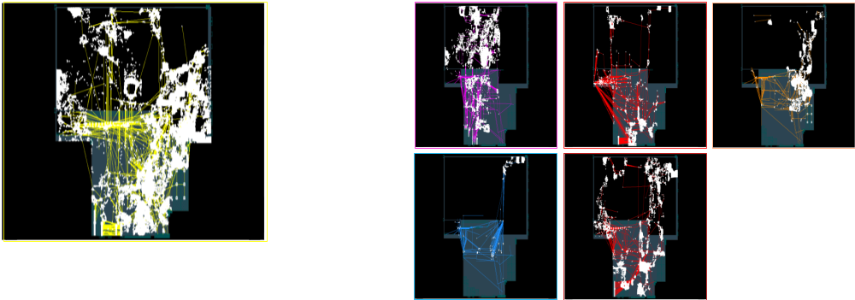
Results – Routing Congestion
SS Floor plan: Low/Mid-Opt CCU fan-out of single C-MUX
SS Floor plan: High-Opt CCU fan out per single C-MUX

Slide 21
Agenda
Problem Statements
Solution and Sub-System Under Test
Clock Controller Design Strategies
Results
Conclusion
Q&A

Slide 22
Conclusion
Multi-Clock Domain approach (Mid/High-Opt) leads to a Switching Power saving and Buf/Inv Insertion reduction.
High Software flexibility (High-Opt) is responsible effects Switching Power while the Internal Power effect is negligible.
Total Area variation is minimal as CCU design changes are negligible respect to the entire design.
Routing Congestions analysis shows that the multi-clock domain approach gives Back-end stage higher flexibility in building the clock-tree.

Slide 23
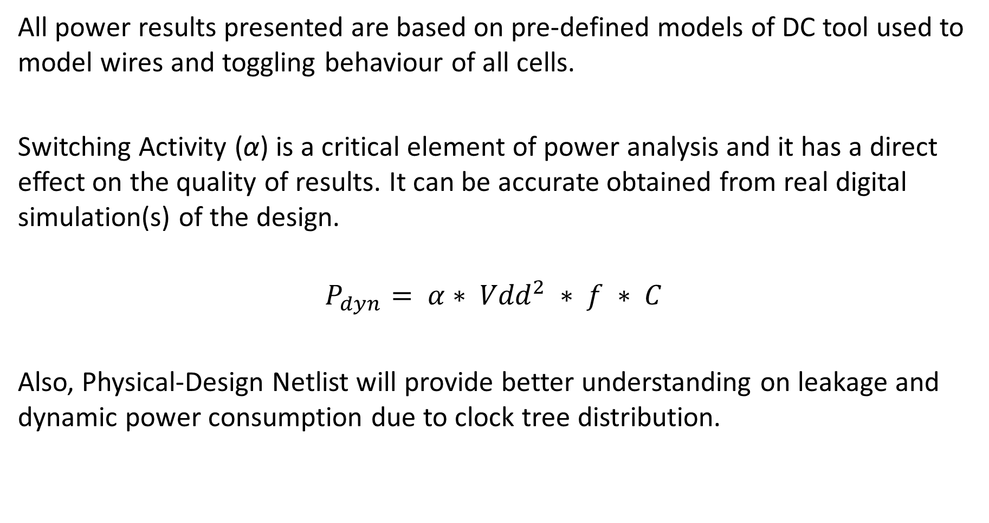
Conclusion – Future Work
All power results presented are based on pre-defined models of DC tool used to model wires and toggling behaviour of all cells.
Switching Activity (α) is a critical element of power analysis and it has a direct effect on the quality of results. It can be accurate obtained from real digital simulation(s) of the design.
$$P_{dyn}= α∗ {Vdd}^{2} ∗ f ∗ C$$
Also, Physical-Design Netlist will provide better understanding on leakage and dynamic power consumption due to clock tree distribution.

Slide 24
Thank You!
Q&A
Qualcomm Snapdragon is a product of Qualcomm Technologies, Inc. and/or its subsidiaries. Qualcomm and Snapdragon are trademarks of Qualcomm Incorporated, registered in the United States and other countries

